Slide 1
SPAN – November 2023

Slide 2
Agenda:
Departmental Spotlight: Marshall Ferguson
Brief Overview of RACC Professional Designations
How to Read a Notice of Award (NOA): (What You Need to Find and Why it Matters)
Updates from SPA and What’s to Come

Slide 3
Departmental Spotlight: Marshall

Slide 4
RACC – CRA / CFRA / CPFA
RACC is Research Administrators Certification Council
They are the Council that manages these professional designations:
Certified Research Administrator
Certified Financial Research Administrator
Certified Pre-Award Administrator
Notes:
If you are interested in obtaining a Research Administration industry designation, go to the RACC website. There is a 250-question test. There ARE study sessions / study groups out there. Take a look at the RACC website it is a good first step. There is a handbook for each designation that outlines the requirements to site for an exam, the cost and the continuing education requirements.

Slide 5
How to Read a Notice of Award (NOA) Marshall Ferguson, Post-Award Specialist, OOR Lin Kaplan, Senior Sponsored Projects Accountant, SPA

Slide 6
Notice of Award - Defined
It’s a legally binding document that contains or references all terms and conditions of the award and documents the obligation of funds.
PIs, OSP, SPA and the departmental research administrators should understand and comply with all award terms and conditions.
Notes:
Marshall – ‘Contains or references’. This is the crutch of why I asked Melinda if I could present to SPAN on the NOA reading topic. I’m sure you’ve all been here before!!! A PI in your department gets a new award….GREAT!!..and then you want to dive in and figure out what’s it’s all about. You get the 1) NOA 2) Excel Budget 3) Budget Narrative 4) Proposal perhaps even the funding opportunity announcement (FOA) and then you starting reading the NOA. And it’s like reading a legal briefing. My eyes glaze over…Outlook email pop up....and…this exercise gets kicked down the road. My goal today is to do a deep dive into a NSF NOA and show you why…1) why research administration has so many rules 2) that you are not ALONE! 3) key information that needs to be highlighted in your NOA within the DRA grant files…highlighted like actually using the highlight tool in Adobe. Because down the line, when a question arises from the PI, you can re-open the document and the highpoints will already pop. Plus…this way you aren’t already working from behind. Like getting the award and then sitting back and waiting for questions to arise. By reading the NOA upon receipt, you are forcing yourself to become very familiar with the NOA and all the award documents at the start.

Slide 7
Example – NSF Standard Grant
The next slides are snapshots of a NSF award housed in Academic Affairs
Each funding agency NOAs are formatted different (DoD, NIH, NEH, State, etc.)
Deep dive then overview

Slide 8
NSF Awards – Composition of an NSF Award
From PAPPG 19-1
Notes:
This is from Chapter 6, section B of the PAPPG 19-1. That’s the Proposal & Award Policies & Procedures Guide. I’m using 19-1 because THAT was the version of the guide when this award was made. The current PAPPG guide is 23-1 but the NSF PAPPG guide webpage says, “Each version of the PAPPG applies to all proposals or applications submitted while that version is effective.” And this award was submitted while PAPPG 19-1 was effective.

Slide 9
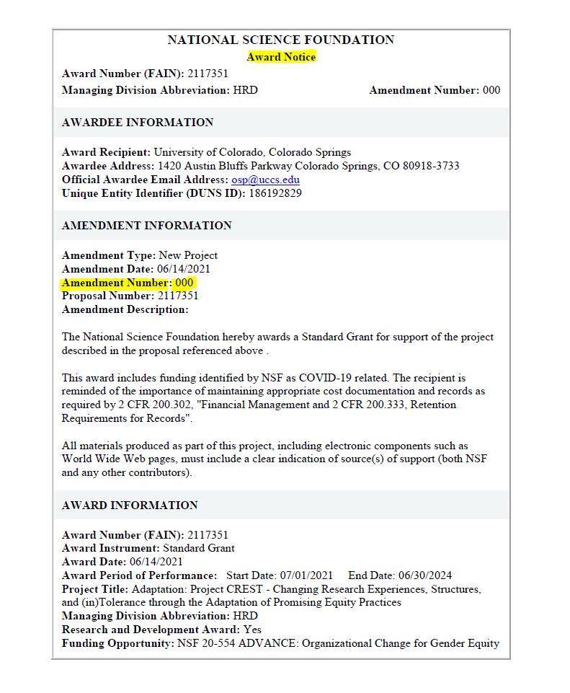
Notes:
Here we see that the Amendment Number is 000, that tell me this is the original NOA,

Slide 10
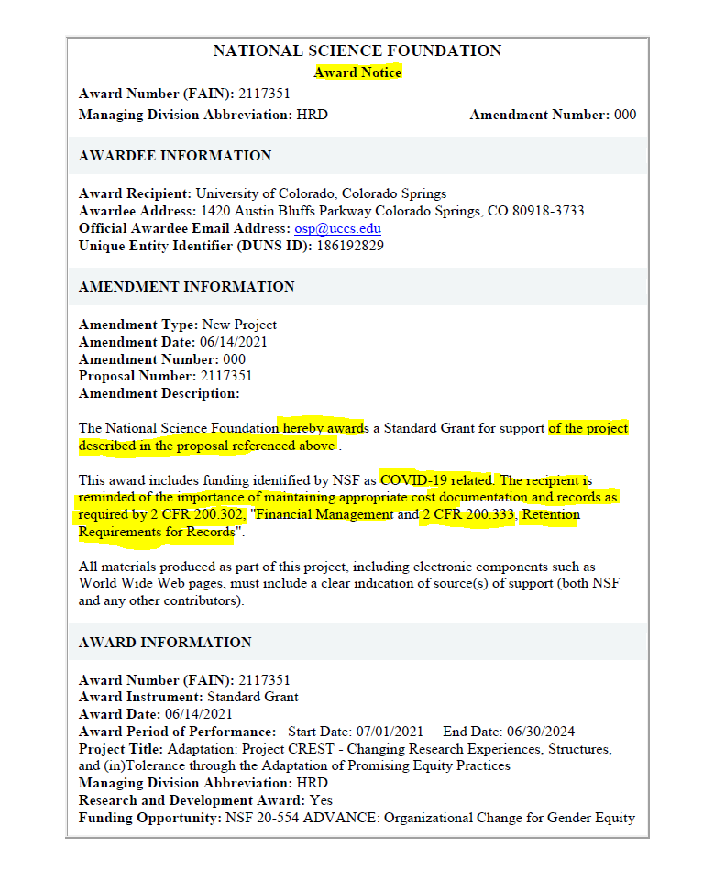
Notes:
NSF hereby awards a standard grant for support of the project described in the proposal referenced above. This NOA is only 5 pages total. If you don’t already have it in the award email from OSP, go ahead and ask for the proposal FROM OSP for future reference and you can keep it in your files. OSP is the source for the final / submitted documents. For instance, I’ve used the proposal to add backup documentation for paying SOW independent contractors for the EAB. The proposal was extremely clear that EAB members would need to be paid $500 per year and also the project WOULD REIMBURSMENT THEM for traveling to UCCS for a site visit. That documentation is housed both in the budget justification but also goes into greater detail in the proposal (a table format of which EAB members are traveling to UCCS in which particular project year). Reading on, “This award includes funding identified by NSF as COVID-10 related”. That doesn’t mean a lot to me but now I know. Oooo okay now we are going to talk 2 CFR. “The recipient is REMINDED of the importance of maintaining appropriate cost documentation and records as required by 2 CFR 200.302, Financial Management”. Great now lets go actually look at 200.302 and see what it says!!

Slide 11
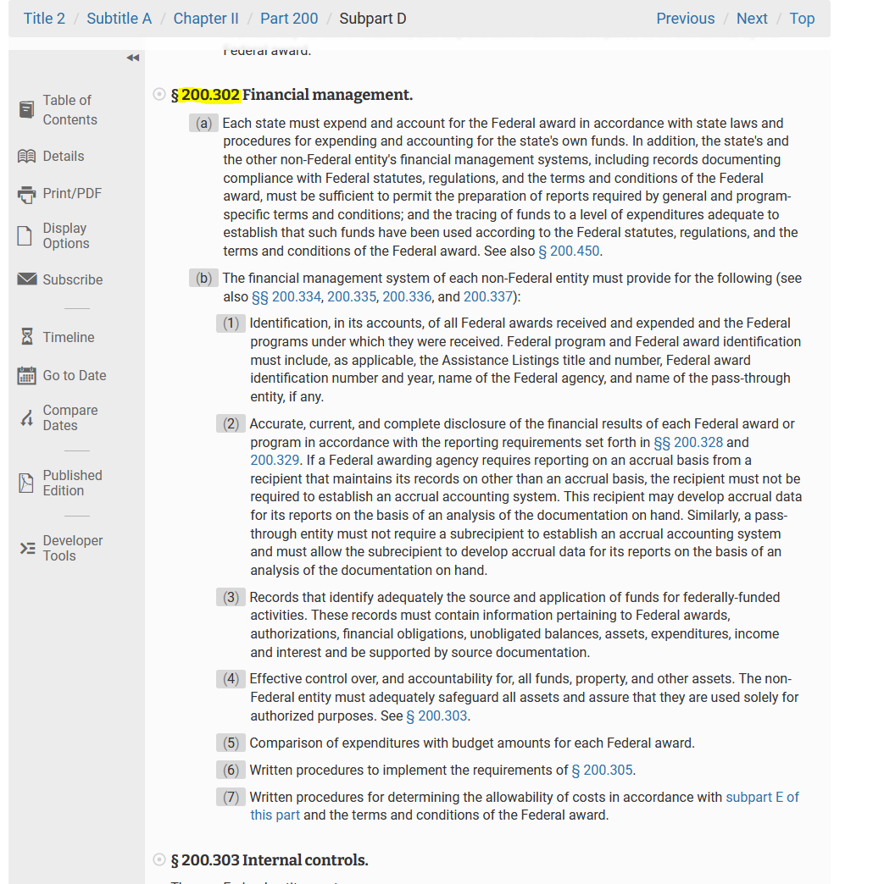
Notes:
“And the other non-Federal entity (that us) financial management system (we use PeopleSoft Financials for the FMS), including records documenting compliance with Federal statues, regulations, and the terms and conditions of the Federal award, must be sufficient to permit the preparation of reports required by general and program-specific terms and conditions; and the tracing of funds to a level of expenditures adequate to establish that such funds have been used according to the Federal statues”. Wow…okay what does that mean? It means we have to have a FMS, we do with PeopleSoft Financials, then what caught my eye was ‘and the tracing of funds to a level of expenditure’…that sounds like using the correct account code. That’s our day-to-day in Concur & Marketplace where we must choose the correct account code.
1) When SPA loads FMS with award data. I’ve heard SPA says new award setups take awhile. We’ll that’s probably why because they are loading relevant data into the FMS as required by 200.302(b)(1).
2) Accurate, current and complete disclosure of the financial results for EACH federal award. Meaning, amongst other things, we don’t lump multiple awarded funds together and we maintain adequate documentation.
3) Records that identify…..authorizations, financial obligations, expenditures…and be supported by source documentation. Meaning…the reason to obtain PI, file and attach PI approvals.
Okay…you get the gist. You don’t want me to recite the all these CFR citations to you. BUT, my overall point is, yes there are CFR citations that are ‘contain and referenced within’ and when you read the definitions and then think of how the are currently applied to our research infrastructure here at UCCS / CU , then they tend to be easier to digest. Plus…I think, if you want to get your feet wet, start with 200.402 – 405 these are the basic considerations for composition of costs (cost principles) and make a lot of common sense.

Slide 12
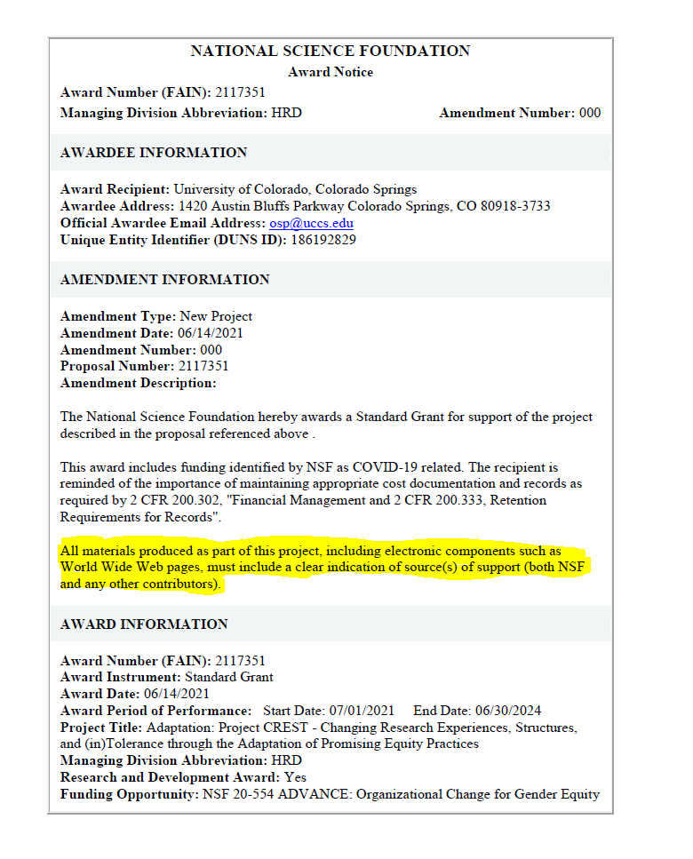
Notes:
Back to the NOA, moving down, “All materials produced as part of this project, including electronic components such as webpages, must include a clear indication of sources of support.” Now this is NOT something DRA should have to monitor for compliance. This is the PI’s responsibility to ensure they cite the funding source on public facing mediums. It’s nice to read on the NOA, and then see it being applied.

Slide 13
Notes:
This slide is proof of practice. The PI and staff project manager is CITING the NSF grant on this public facing website. Similarly, posters created also use this same citation at the bottom.

Slide 14
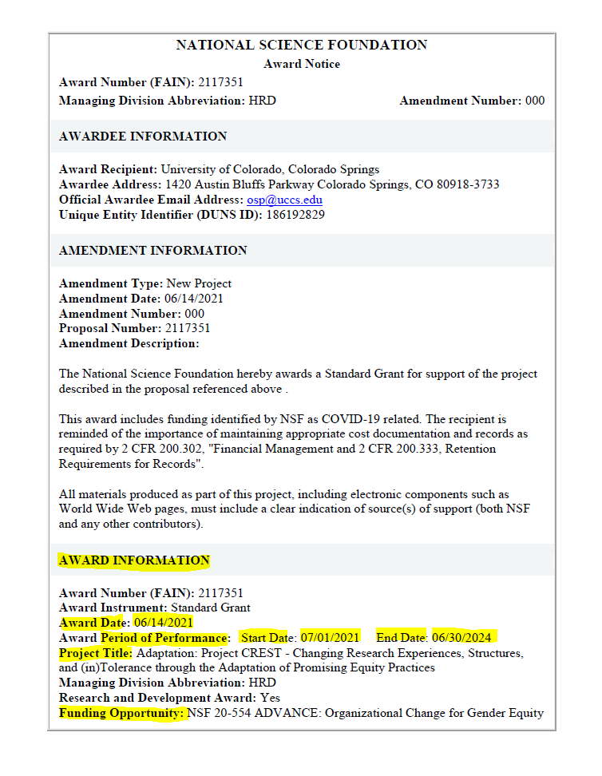
Notes:
Okay, continuing to move down the document. Now we are in the Award Information section. This sections houses data points that you will be more familiar with: Award Date – is when the award was ‘made / communicated’. Period of Performance: 7/1/2021 – 6/30/2024. Project Title – this is a LONG title. Often times PIs will use short-hand. Meaning for this award, often we’ll just refer to it as just “Project CREST”. Funding Opportunity: this is the NSF funding opportunity for which the funded proposals was submitted to. Okay, we are now past page 1!!!

Slide 15
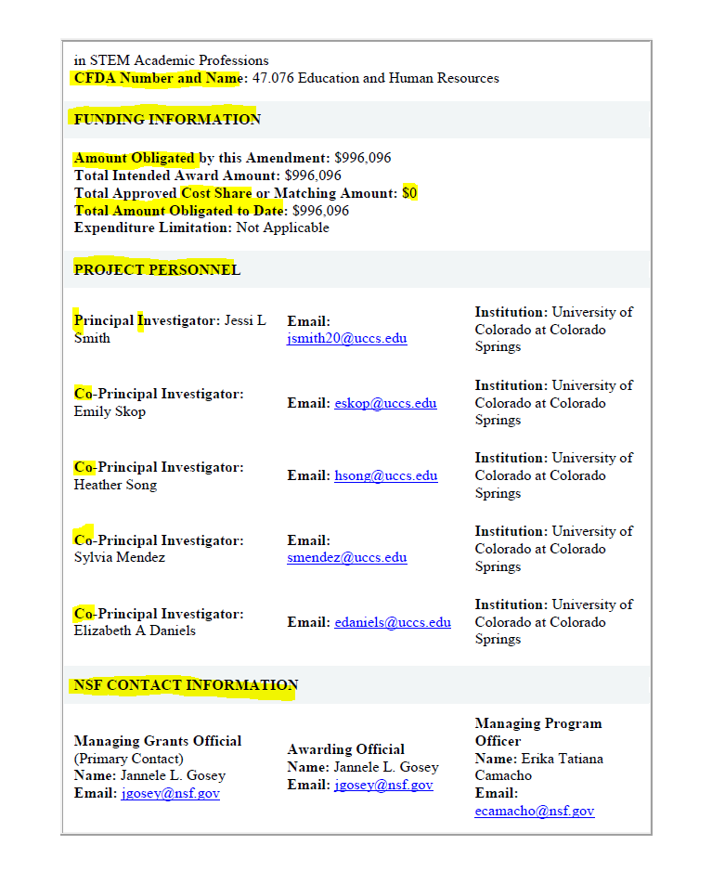
Notes:
Page 2 – CFDA Number and Name – this is the “Catalog of Federal Domestic Assistance” this is the assistance number funded by the Federal Government.
FUNDING INFORMATION section!! Award Obligated by this Amendment (NOA amount). No cost share.
PROJECT PERSONNEL section – Lists the senior personnel.
NSF CONTRACT INFORMATION - I don’t use, for PI / OSP / SPA reference

Slide 16
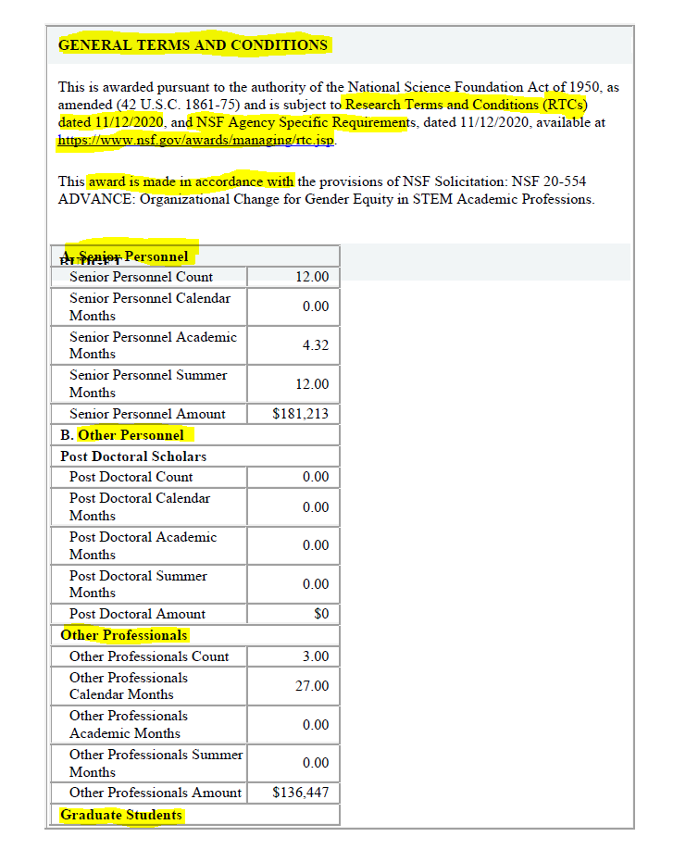
Notes:
Page 3 of 5! GENERAL TERMS AND CONDITIONS I go to the NSF website and search “Research Terms and Conditions” This will pull up the RTC main hub page. Here we find the “Research Terms and Conditions Overlay to the Uniform Administrative Requirements Dated 11/20/2020” This is a 32 page document, in a table format, that is SEARCHABLE. It has Uniform Guidance on the left and overlay on the right. THE WHOLE point of this is CLARIFICATION to UG. Also housed in the RTC is MY PERSONAL FAVORITE the Prior Approval Matrix.
Moving on – FINALLY the actual budget. I’m not going to go line by line because each award is different BUT here is where you can reconcile the Account Setup Form, to m-FIN, and make sense of that, BACK to the NOA budget.
LIN – jumps in and explains why certain account codes are used and the limitations of budget coding

Slide 17
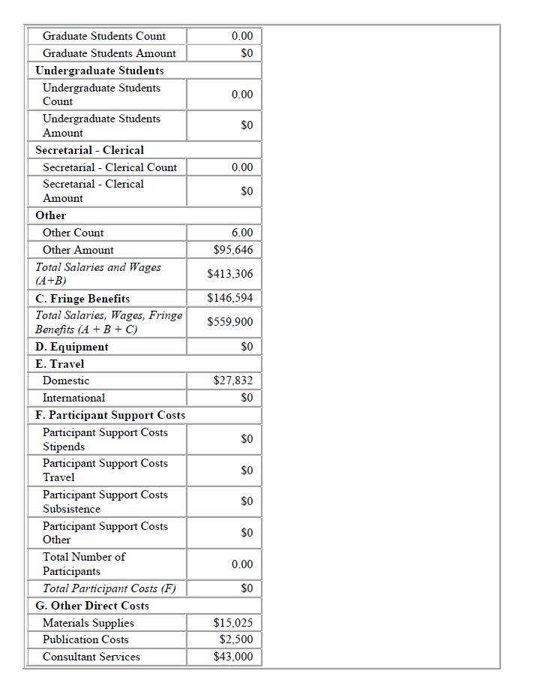
Notes:
Page 4 of 5, more budget information. No comments.

Slide 18
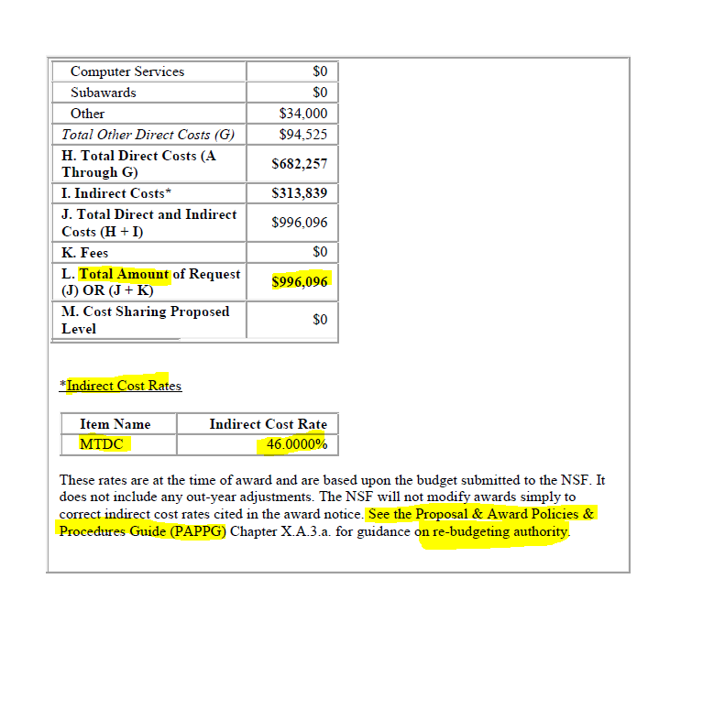
Notes:
Page 5 of 5!!! Here is the end of the budget table. We can see / verify the indirect cost rate / F&A rate. See that we this F&A is applied via the Modified Total Direct Cost method.
FINALLY, we read that it says reference the PAPPG guide for re-budget authority.

Slide 19
So why read an NOA?
Provides the basic and essential information needed to understand the contractual agreement between UCCS and the external sponsor
Helps contextualize the project and its expenditures.

Slide 20
Key Elements to Any NOA
Award Type
Budget/Performance Period and Award Period
Performance Period Budget (vs. Future Funding)
Cost Sharing Commitments
Funding Restrictions
Milestones
Other Project Specific Terms and Conditions
Notes:
Formatting of NOAs differ by sponsor and award. Whether the NOA is 5 pages of 135 pages long, always look for these key pieces of information about any award that you are supporting.

Slide 21
Questions?

Slide 22
On the Horizon for SPA…
Website Updates…
Refresh and Reorganization of the SPA website
Adding a table summarizing: “Who should I reach out to for this?”
Can be used by PIs, Departmental Admins, and all Project Staff
New SPAN Topics…
Subcontracts (Incoming)
Subcontracts (Outgoing)

